Slide 1
Mojo Programming Language
System programming

Slide 2

Basic knowledge of Programming

Slide 3
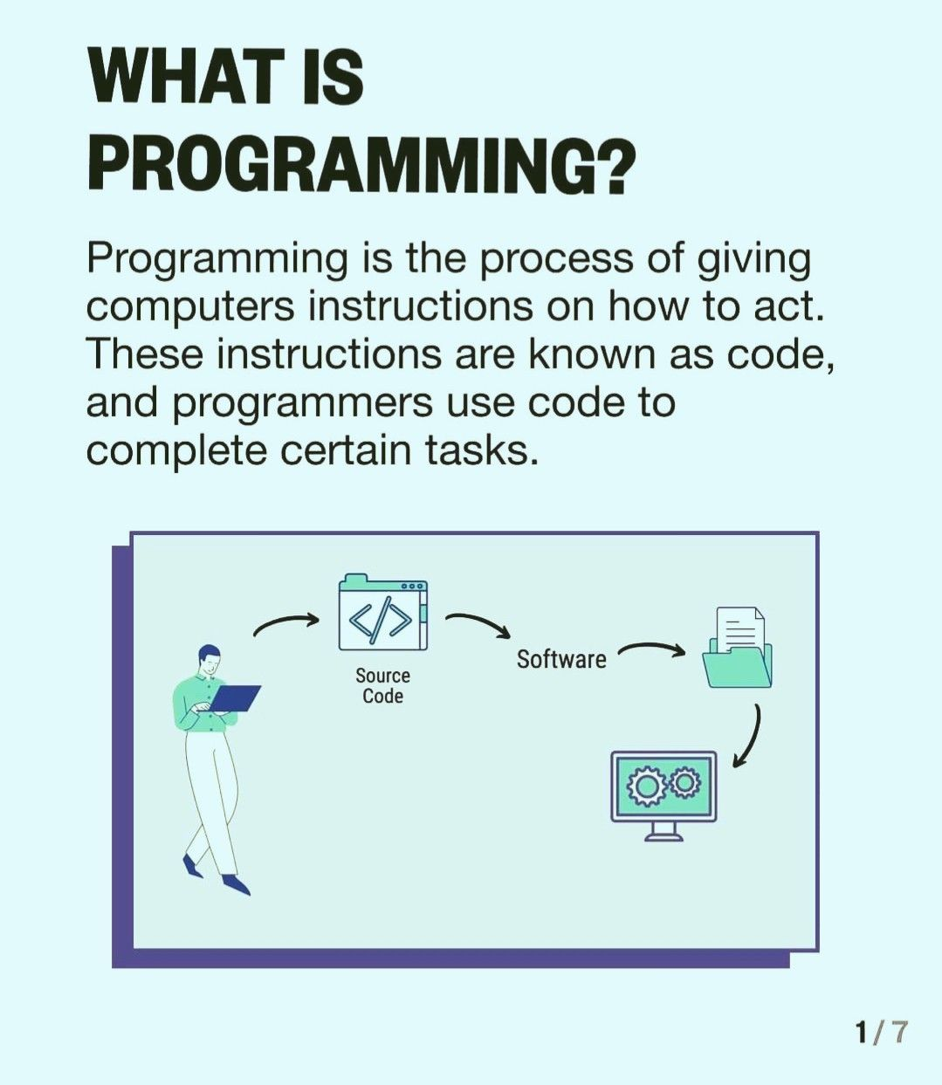
What is programming
How to let computer know what we need to do?
We need a language to let computer understand us, know what we asked them to perform.

Slide 4
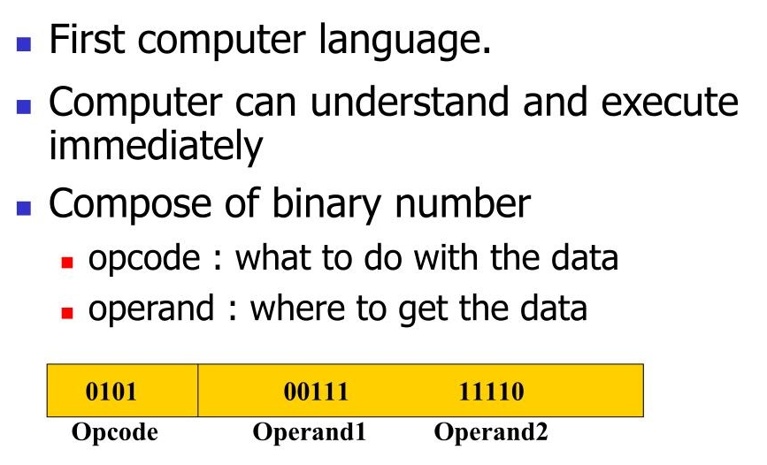
Languages Computer Can Understand
Machine Language

Slide 5
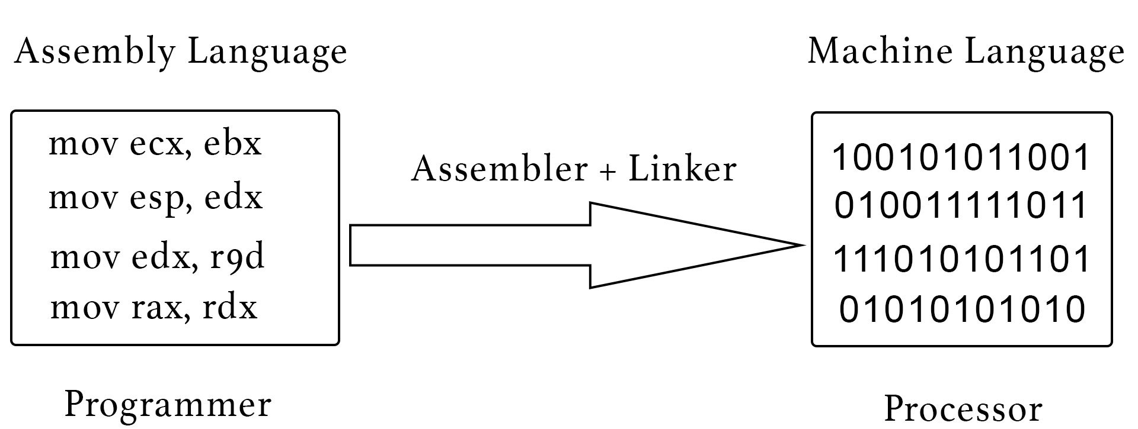
Languages Computer Can Understand
Assemble Language

Slide 6
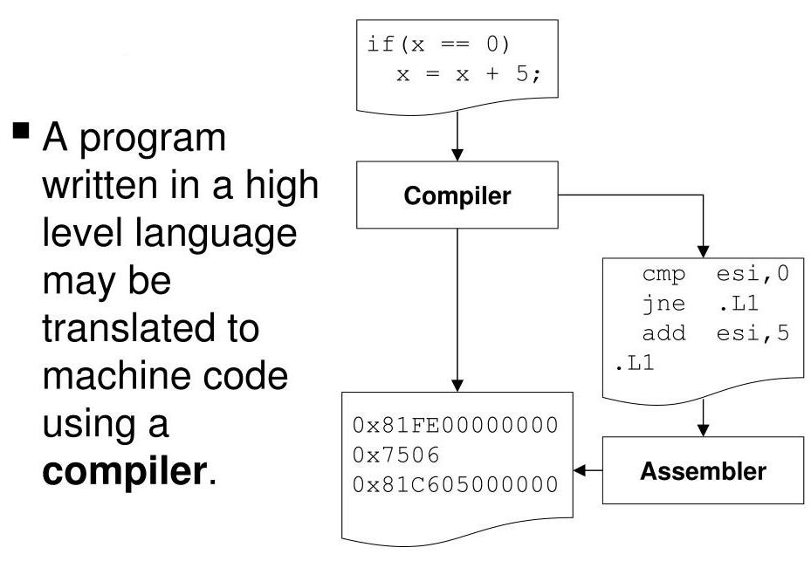
Languages Computer Can Understand
High level programming language

Slide 7
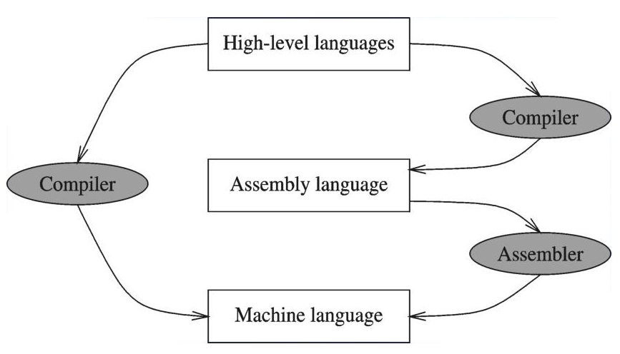
Compiler and Assembler

Slide 8
Mojo Programming

Slide 9
What is MOJO
A high level programming language
by Modular, an AI infrastructure company
Similar with python syntax, compatibility with python ecosystem
Fast and Versatile, high performance, parrallel computing
Memory safe

Slide 10
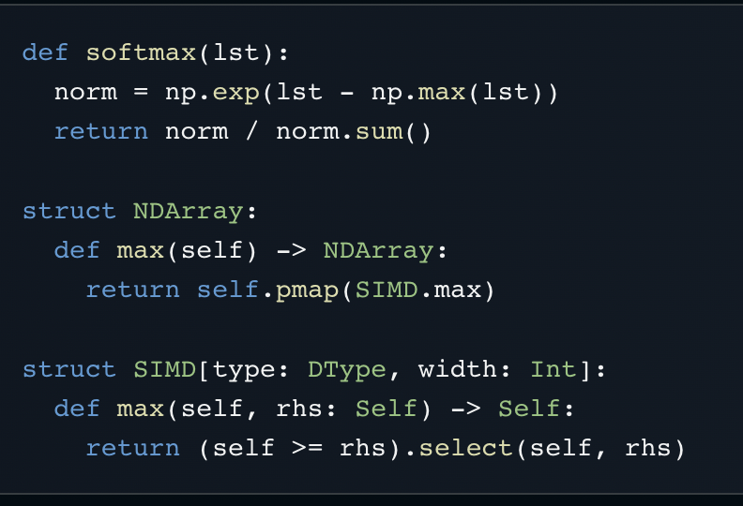
MOJO code
Use `def` to define new functions
Use `var` to declare variables
Use `struct` to define new data types, which can have attributes and methods
Code block: same like python, use indentation changes as the start and end of code blocks.

Slide 11
Variable

Slide 12
Variable
A variable has 3 associated factors:
  A name / identifier
  A location, (a piece of memory, memory address and memory size)
  A data (data type, and actual value of the data)
  Memory size is related with the data type

Slide 13
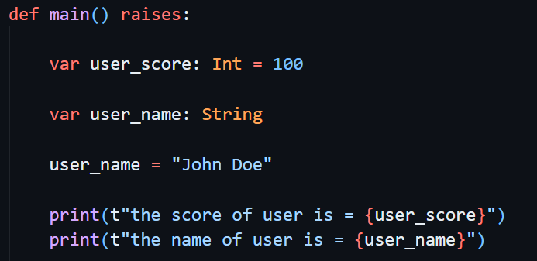
Variable
Has all 3 factors.
Variable name: user_score
Memory size: the size fit for Int
Memory address: assigned
Data type: Int
Data value: 100
When declared only have:
Variable name: user_name
Memory size: not decided
Memory address: not assigned
Data type: String
Data value: no actual value
After assignment all have:
Variable name: user_name
Memory size: fits actual storage
Memory address: assigned
Data type: String
Data value: “John Doe”

Slide 14

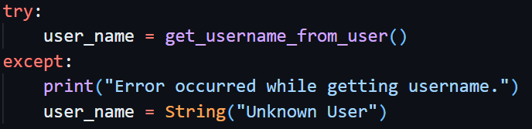
Variables
Normal variable, name, data, memory, all properly set. But there are 2 exceptional situations:
Uninitialized: if a variable defined, has name, has data type, already determined the memory size needed to put a value in, but did not given a value yet, so no memory address, no actual value.
Temporary value: if a value was created using constructor, or as return value of a normal function call, those value has memory address, has actual value, also determined the data type, the memory size, only it does not bind a name.
Uninitialized variable can be assigned with a value, then become a normal variable.
Temporary value can be assigned to a variable (bind with the name), then become a normal variable. If assign a temporary value to a variable, if the original variable already has memory address and actual value, it can be abandoned(destructed) and take the memory piece of the temporary value, or move the value to existing location.

Slide 15
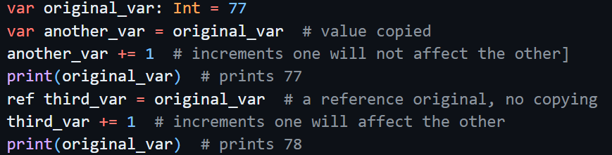
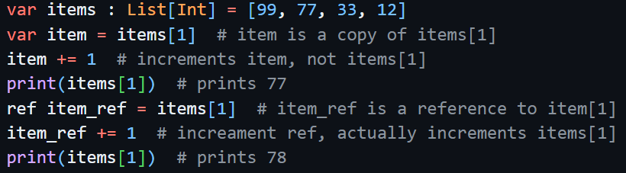
Reference Binding
Mojo use var to declare a variable with name binded to actual value / memory piece.
Mojo use ref to declare a new name (alias), reference bind to actual value / memory piece. (the value / memory piece cound be referenced using a variable name declared by var, or one element in List, or one attribute of a struct, etc., which has actual value. Also can ref to ref, which is actually ultimately ref to the final one with actual value.).
In this way, the original value binding is like a formal name, this ref declared name is like an alias_seconday_name to the original.

Slide 16
Data Types

Slide 17
Data Type
All values in Mojo have an associated data type.
Most of the types are nominal types, defined by `struct`. The equality between these types is determined by type’s name.
2 types in mojo not defined by struct:
  Functions are typed based on their signature
  NoneType is a type with one instance, the None object

Slide 18
Numeric Data Type
Numeric types include:
  Integers (`Int`) and unsigned integers (`Uint`)
  Decimal values (`Float64`)
Mojo has different memory size for integer and decimal values, like Int8, Int16, Int32, Int64, Int128, Int256, Float16, Float32, Float64, etc. For float, also has some specific type for GPU & AI programming.
Integer literals default convert to Int, decimal literals default convert to Float64.
IntLiteral and FloatLiteral are compile time types, with arbitrary-precision (or called infinite-precision). At runtime they materialize to runtime types.
Runtime types like Int and Float64, with limited precision limited range, round error can happen.

Slide 19
SIMD and DType
To support high-performance parallel computing, Mojo uses SIMD (Single instruction, multiple data) as the basis for its numeric types.
SIMD need 2 parameters:
  A DType value, defining its data type
  The number of elements, which must be power of 2

Slide 20

Numeric Types: Alias to SIMD
Scalar is SIMD with only one element
Int32, Float64, etc, are SIMD with specific DType and only one element

Slide 21
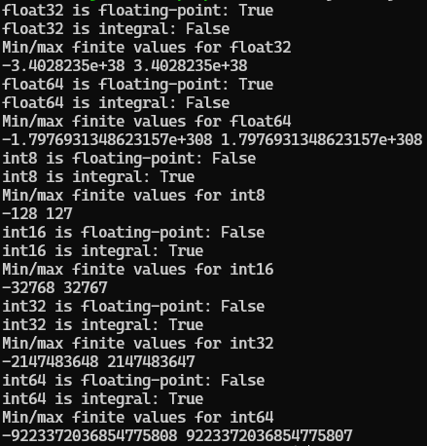
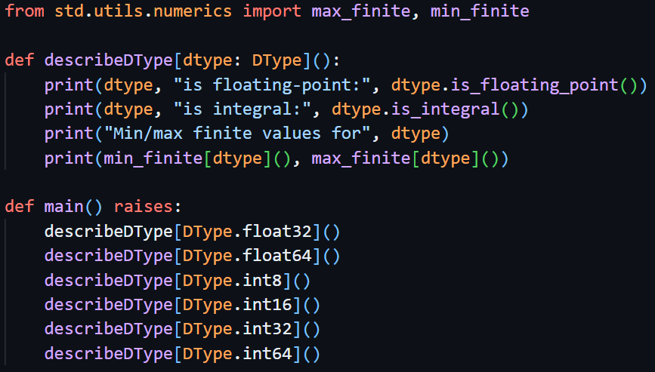
Know more about runtime numberic
Run the above program, give the result:

Slide 22
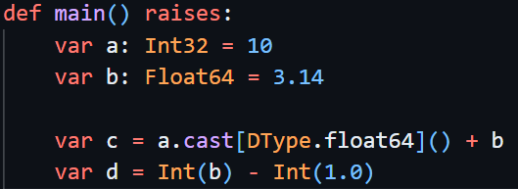
Numeric type convertion
If source and target are 2 different values with different types, you can convert their types explicitly using the following ways:
  Use target type constructor which accepts the source types as arguments
  Use source type value and call method cast to convert to target
Any data type conform to Intable trait, can be explicitly converted to Int type with Int() constructor.

Slide 23

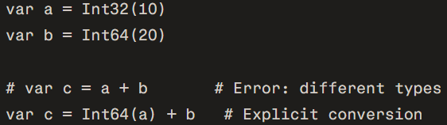
Numeric Type Conversion When Materilize
IntLiteral can implicitly convert to integer or unsigned integer types, FloatLiteral can implicitly convert to float types
IntLiteral can implicitly convert to float types provide context are there, FloatLiteral cannot implicitly convert to any integer types
Runtime value need do explicit convertion, even integer to integer, float to float.

Slide 24
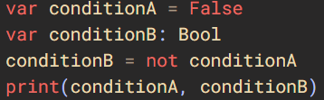
Boolean Data
Boolean algebra is a branch of mathematics developed by George Boole where variables have only two possible values: True or False.
It uses three core operations—and (conjunction), or (disjunction), not (negation)—forming the foundational logic behind computer programming, digital electronics, and circuit design.
In Mojo programming, this data type is called Bool. It is not like numeric data, is not alias of SIMD. It is a independant struct definited, no direct relation with other data types.
Any data which conform to Boolable trait, can be explicitly converted to Bool type using constructor Bool().

Slide 25

String Type
Mojo String:
  Store UTF-8 encoded text
  Provide a safe, ergonomic interface for string manipulation
  Is mutable

Slide 26
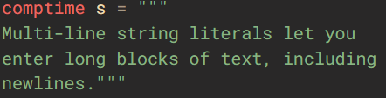

String Construction
StringLiteral (comptime) can be implicitly converted (materialize) to String type (runtime).
Other data, need use String() constructor to explicitly make String data at runtime. Any data type conform to Writable trait can use this way to make the convertion.

Slide 27
String Data Length
Mojo source files are UTF-8, so can write emoji and other non-ASCII characters directly inside string literals, like "👨‍👩‍👧‍👦 " , "🇺🇸 " , "👋🏽 ", "🙏 "
Length has 3 different ways to calculate:
  byte_length() returns the number of UTF-8 bytes.
  count_codepoints() counts the Unicode code points.
  count_graphemes() returns the number of user-perceived characters (grapheme clusters)
The grapheme count is what matches what a human would tell you if you asked them to "count characters."

Slide 28
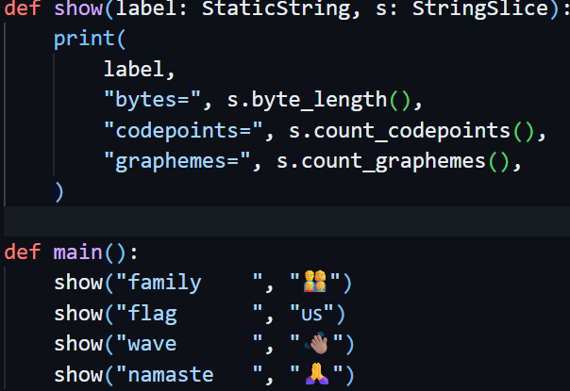
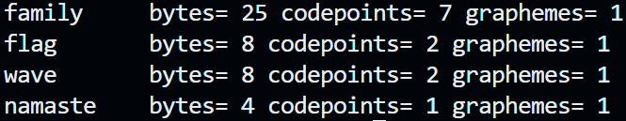
String Data Length
Run the program, give this result:

Slide 29
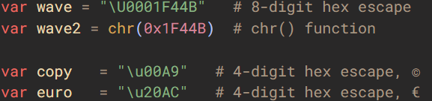
Other ways to have UTF-8 special character
2 ways:
  Use hex escape
  Use chr() function. The function takes Int as argument, and return String.

Slide 30
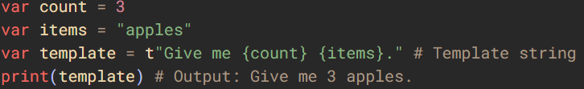

String Formatting
2 ways:
  Use .format() method
  Use template string

Slide 31
Assignment
Normal variable assignment, default action will copy the value of second to the first, so the variable type must be copyable. If 2 variable are different types, must be implicitly convertable.
For variable with non-copyable data types, if use variable assignment, compiler will compalin error, you must explicitly use ownership transfer to make it happen, date type must be movable.
But a temporary value, if it is non-copyable data type, it can be assigned, even the origanl name binded with actual value. The original value will be abandoned(destructed), and Move Initialization/RVO(return value optimization) will happen, the name will bind with the new temporary value.
If a data type is non-copyable, and also non-movable, then assignment like var_a = var_b cannot compile.

Slide 32
Functions

Slide 33
What is Function
Function is a collection of many code, organized together to do certain specified work.
  A struct can have functions inside it’s definition, this is normally called struct methods.
  A funtion can be defined outside any structs, in the global/module level.
  A function defined, does not mean the code will get executed. When a function is called, that is the time the code inside the function get executed.
  A mojo program need have one main() function, which is the entrace of the program. System will automatically call this main() function to start running the program.

Slide 34
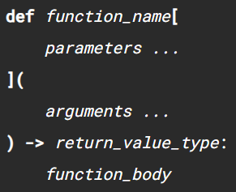

Mojo Functions
Mojo uses def to define a function, similar like python.
Parameters: A function can optionally take one or more compile-time parameter values used for metaprogramming.
Arguments: A function can also optionally take one or more run-time arguments.
Return value: A function can optionally return a value.
Function body: Statements that are executed when you call the function. Function definitions must include a body.
A important difference with other programming language:
Parameters are for comptime.
Arguments are for runtime value passing.
A minimal function:

Slide 35

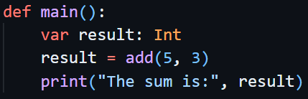
Arguments and return value
Arguments are values passed by caller into the function during runtime
Return value is the value returned from the function to the caller when function finished

Slide 36




Return value
Can use -> return value, also can use named result in the argument list as return value. They are equivalent:
If no return value, it can be omited, or use return None. They are equivalent:

Slide 37
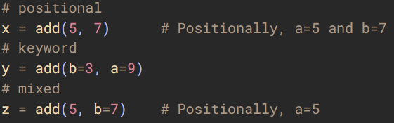
Caller: specify value for arguments using positional or key word
Positional: match caller’s value to arguments in function definition with position
Key word: match caller’s value to arguments in function definition with name
Positional must be before key word, key word must be after positional. Cannot use add(a=10, 20) #Error
If caller all argument using key word to make the call, then order does not matter.

Slide 38
Require for positional / key word arguments when define function
Can specify which arguments must be position, which must be key word, when define the function
Arguments before the / can be passed only by position. Arguments after the * can be passed only by keyword

Slide 39

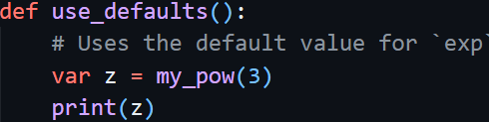
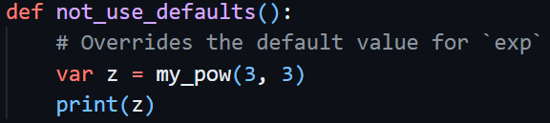
Optional arguments: give default value when define the function
An optional argument is one that includes a default value when define the function. If caller did not omit and give a value, it will use that value. If caller omit this argument then default value will come in instead.
Optional arguments must appear at the end of argument list.

Slide 40
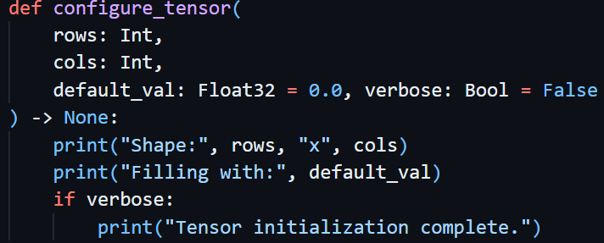
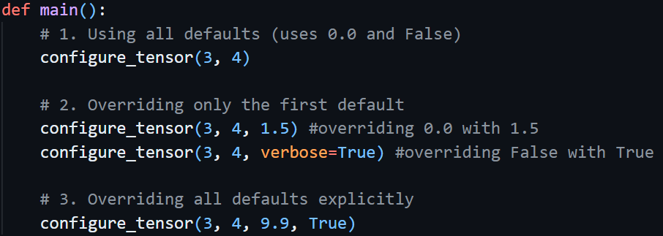
More than one argument with default values
We can define a funtion with more arguments have default values.

Slide 41
When argument number is variable
In Mojo this is called Variadic Arguments.
An argument name prefixed by a single star character, like *names identifies a variadic argument, while an argument name prefixed with a double star, like **attributes identifies a variadic keyword-only argument.

Slide 42
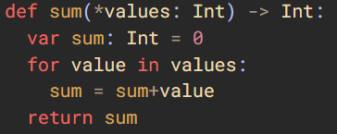

Variadic Argument

Slide 43
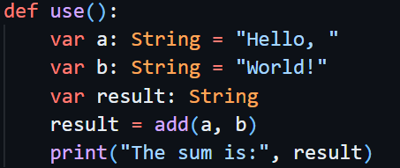

The calling process: values in caller and arguments in callee
You may think of the calling process is like assignment: values in caller assigned to the arguments in callee. But that is not the case.
In assignment, default action is copy: var_a = var_b, the value in var_b copied to var_a.
In function calling, default action is to make the argument as a readonly reference. You can think of original var_a in caller is the formal name, and argument inside the called function is an alias_secondary_name binds to the same value, same memory piece.
The reason is for performance. If the data type occupies many memory, copy like assignment will affect the performance. Reference (an alias name) will share same memory piece, increase the performance.

Slide 44
The calling process: values in caller and arguments in callee
read: this is the default action. The function receives an immutable reference. This means the function can read the original value (it's not a copy), but it can't mutate (modify) it. It is same as
mut: The function receives a mutable reference. This means the function can read and mutate the original value (it's not a copy).
var: The function takes ownership of a value. This means the function has exclusive ownership of the argument. The caller might choose to transfer ownership of an existing value to this function, but that's not always what happens. The callee might receive a newly-created value, or a copy of an existing value.
ref: The function gets a reference with a parametric mutability: that is, it follows the mutability of the referenced value. ref arguments are an advanced topic, and they're described in more detail in Lifetimes, origins, and references.
out: A special convention used for the self argument in constructors and for named results. An out argument is uninitialized at the beginning of the function, and must be initialized before the function returns. Although out arguments show up in the argument list, they're never passed in by the caller.
deinit: A special convention used in the destructor and consuming-move lifecycle methods. A deinit argument is initialized at the beginning of the function, and uninitialized when the function returns.
read is the default action (arg is readonly ref), var like variable assignment (arg is a new independant variable, the caller’s value either copied or moved).

Slide 45
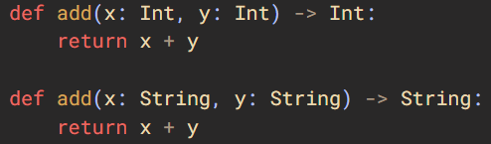
Overloaded functions
Overloading: one function name, with different argument types.
When you want use this add() function, if you pass value different from String or Int, you will get compiler error. If you use String / Int, compiler will find which one is correct and arrange code to call the correct one. String can be implicitly converted from StringLiteral, so passing StringLiteral values are also OK, compiler knows to find which one.

Slide 46
Overload resolution
An "overload set" is a collection of function overloads that share the same name but different signatures.
When resolving an overloaded function, Mojo looks at:
  The number of the arguments, the position and keyword of each argument.
  The type of each argument.
  The argument conventions on each argument.
  Whether the candidate is an instance method or @staticmethod.
  Whether a constructor is @implicit.

Slide 47
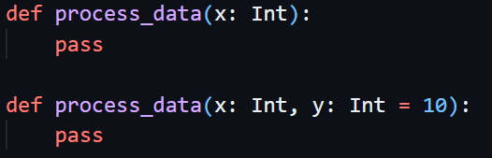

Overload resolution
When calling a function name, mojo looks at the values provided and compare to the overload set function signatures:
  Candidates requiring the smallest number of implicit conversions.
  Candidates without variadic arguments.
  Non-@staticmethod candidates (over @staticmethod ones, if available).
A typical mistake: if 2 functions, signature only differ with optional arguments, it will cause ambiguity error.
You can combine the 2 functions into one, or make the second argument keyword only.

Slide 48
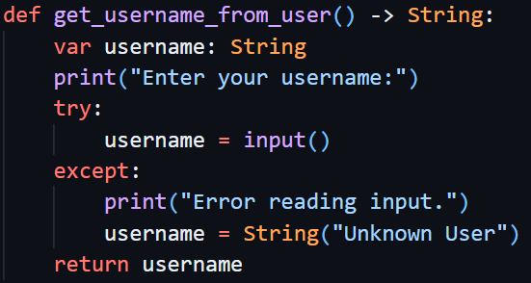
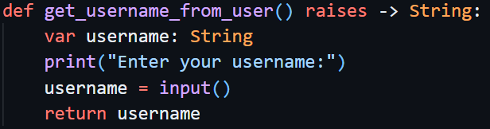
Raising and non-raising
When error happened during execution, program can raise error.
If a function has possibilities of raising error, either error are properly handled inside the function, or if the error will propogate up to the caller, the function declaration must include raises key word. It is placed after (arguments list) parenthesis, before -> return type.

Slide 49
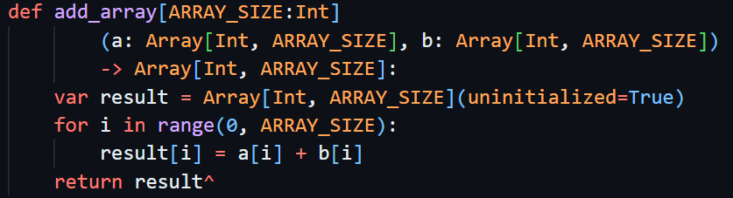
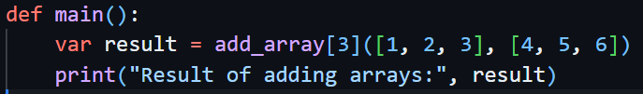
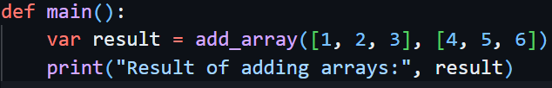
Parameters in function
Parameters are special in Mojo, which does not like other programming language, where parameter and argument can interchange, means same.
In mojo, parameters must be comptime values. When comes to runtime, they become constants. Thus, in runtime, compiler materialize different parameters into different functions.
If from caller context compiler can infer the value, it can be omited when you make the call.

Slide 50
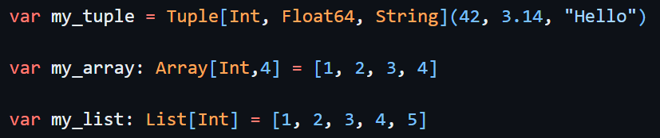
Some Data type (struct) also defined to change based on Parameters
Not just function, struct also can have parameters.
In the following code Array is a struct defined to take parameters, one of the parameter is comptime Int value, which we give `4` in this code.
DType values like DType.float64, DType.int, are comptime values.
But Float64 is alias to SIMD[DType.float64, 1], it is a struct type not a comptime value.
So parameters has 2 types: one is comptime values, another is type parameters.
The type parameter is called generic programming, it makes the data type (the struct) can change to process different types data.

Slide 51
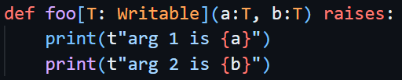
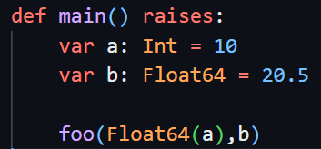
Function can also have type parameters
Generic programming needs to know how traits working. We will dicuss more details when we come to learn traits.
We can see the following code to get know a little bit about it. The argument are data types not finally decided when you writing the code, you only request them to be a data type conform with Writable trait, and both must be same type. This kind of function called generic function, because they can be used for different actual data types.
When using this function, compiler will decide that both are Float64 types, and make a function code which can process this Float64 data type for this generic function, and call to this generated function code.

Slide 52
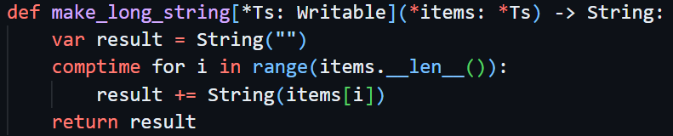
Function can also have type parameters
Here is a more complex situation, generic programming together with variadic arguments.
This function uses VariadicPack (variable arguments, each argument can be different type), and generic programming (argument data type decided by parameter)
The VariadicPack needs to be iterated and processed at comptime so compiler knows each item data types and produce correct runtime code for each item.

Slide 53
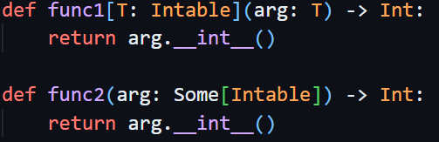
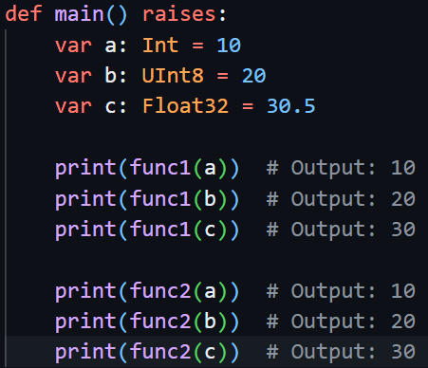
Function generic with trait and Some[]
Mojo has Some[], this struct can dynamically link to different data type as long as they conform to specified trait.
The function defined generic pattern using trait, with function defined using Some[] as arguments, may looks similar, if you want call the function, and the return value, all quite similar. But actual inside is different.

Slide 54
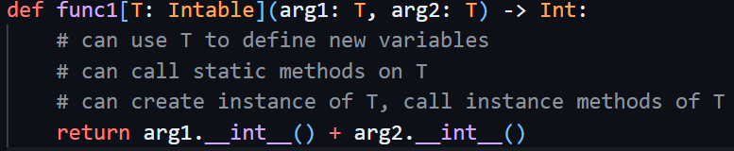
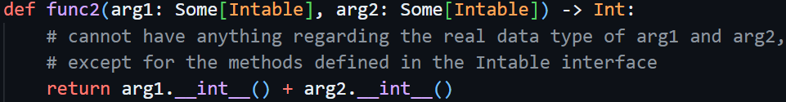
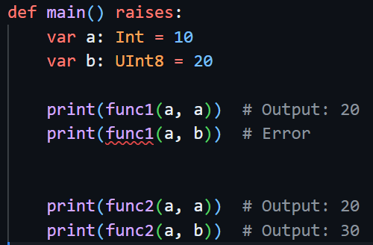
What is the differences?
Inside func1, you can use the data type T, but inside func2 cannot.
Caller also a little diffrence:
func1 must have exact same type or implicitly convertable.
Func2 does not matter, as long as conform to Intable, can be different types.

Slide 55
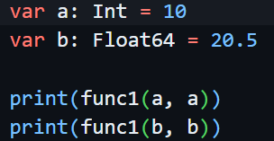
What is the differences?
For func1, if you use different data type to call it, compiler will make 2 different functions for you. At run time 2 functions will be 2 different codes.
For func2, it will always be same code, internally the Some[] implemented vtable and enable dynamic dispatch find the correct method of Intable trait to call, at run time.

Slide 56
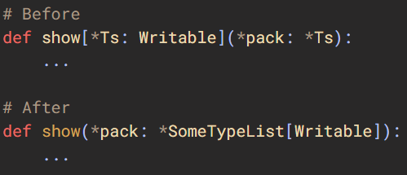
Variadic with SomeTypeList[]
We already used Variadic with Generic programming using trait when we learn functions.
We can also use another way, which need use a new data type with parameter, SomeTypeList[trait_to_conform].
Note, same rule like VariadicPack, it needs to be iterated at compile time, so compiler can handle each item with correct data types of them.

Slide 57
Overload resolutions for functions with arguments and parameters
When calling a function name, mojo looks at the values provided and compare to the overload set function signatures:
  Candidates requiring the smallest number of implicit conversions (in both arguments and parameters).
  Candidates without variadic arguments.
  Candidates without variadic parameters.
  Candidates with the shortest parameter signature.
  Non-@staticmethod candidates (over @staticmethod ones, if available).

Slide 58
Collection Data Types

Slide 59
Collection Data Types
In Mojo std library, include a basic set of collection types:
  Tuple, an immutable colletion of data values, can be different type.
  Array, a fixed size array of items, all items must be same type. Data value are using stack memory.
  List, a dynamically-sized array of items, all items must be same type. Using heap memory.
  Dict, an associative array of key-value pairs, all keys must be same type, all values must be same type
  Set, an unordered collection of unique items.
  Optional, represents a value that may or may not be present.
Collection types are generic, you can specify the type of elements in the collection at compile time using parameter.

Slide 60
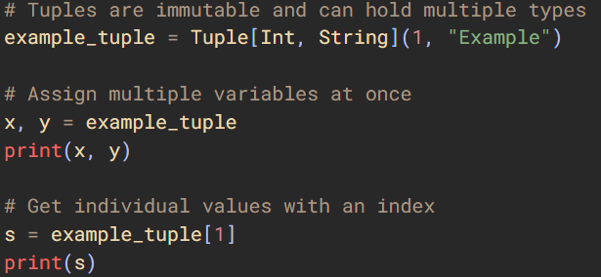
Tuple
Immutable (cannot change value), compile time definition (use compile-time parameter brackets to define the type layout explicitly)
zero or more elements. (zero elements: var tuple_a: Tuple[] = ())
elements can be different types (Heterogeneous)
index into tuple (tuple_var[0], tuple_var[1], etc.)
No easy for loop to iterate over all elements like python

Slide 61
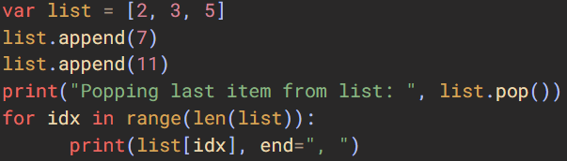
List
List is dynamic, means it can add element, remove element, thus length can change
All elements of list must be same type, and conform to Copyable trait
List has some methods, can call those methods to do some manipulation of list

Slide 62
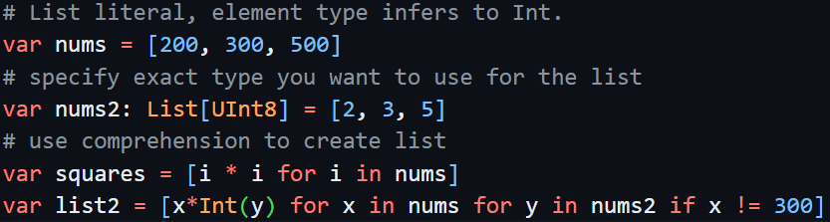
List
List creation: use list literal, use comprehension.

Slide 63


List
Iterating a list, returns immutable reference to each element. If you want mutate the element value, use ref key word to get a reference (because List is mutable, so the ref is also mutable).

Slide 64

Slice
Mojo support slice, and syntax looks very similar to python. But the actual under hood is different. Python return a shallow copy, but mojo is different.
In Mojo, if the result memory is continuous, slice return a Span type, which is a view of original List data. If change the data through this view (Span type), it is actually changing the original data in List.
If the result is not continuous, like [::2] will skip every second item, then mojo will make a copy. The return will not be Span, but a new List with value copied from the original List, their values will be independant with each other.
Same like in python, the slice index items, start is included, end is excluded.

Slide 65

Dict
Associated array of key-value pairs.
All Key must be same type, and conform to KeyElement trait. All value must be same type, and conform to Copyable trait.

Slide 66

Dict
When iterating over Dict, iterator all yield references, you cannot mutate the value.
If you use the value through the reference, data value will be copied into the variables you defined.
Same like List, you can use ref to get a reference and mutate the value.
Temporary value will be created, actual data copied to the temporary value using the reference, the temporary value then passed the print() function call.

Slide 67

Set
A set of unique values. (no same value in set).
Element must conform to KeyElement trait.
To iterate over set, only can get immutable reference. You cannot get a mutable reference and mutate the value of an element.
You cannot directly modify one element’s value. You can only do a remove of the old element then add a new element with new value.

Slide 68



Optional
A value may or may not present. The value must conform to Copyable.
It evaluated to True if have value to False if not. Use value() to get a reference to the value. If the optional has no value, call to value() result in undefined behavior. The or_else() muthod will give the value (not reference) if have, if it does not have then return a specified default.

Slide 69
Operators

Slide 70
Arithmetic Operators
+(addition), -(subtraction), *(multiplication)
  works like normal math. The 2 numbers must be exactly same data types. Even one number is Int, another number is Int32, still cannot go through compiler.
  Returned result is same type.
**(power)
  Works like normal math. Float type base can also accept Int type as power. But Int type base cannot accept Float type power.
  Returned result same type as base number.
  It is right associative.

Slide 71
Arithmetic Operators
/(division)
  The 2 numbers must be exactly same data types. Even one number is Int, another number is Int32, still cannot go through compiler.
  Returned result is same type. For Int type, value will be truncated towards 0. For Float type return the exact decimal float value.
//(floor division)
  Similar to /, 2 numbers must be exactly same type, return type will be same.
  only the value returned truncated towards negative infinite, not towards 0.
  Note that for Float type also truncated towards negative infinite, so final return value would be a whole number in float format, like return 3.0 if mathematical division result is 3.5
%(remainder)
  Remainder = a – b*(a//b). 2 numbers must be exactly same type.
  Remainder will be same sign of the divisor b.

Slide 72
Arithmetic Operators
-(negate)
  Negates for following number, or expression result.
+(no-op, identity)
  Does not have any effect.
~(bitwise invert)
  Only on Int type. Cannot work on Float type.

Slide 73
Arithmetic Operators
@(matrix multiplication)
  The intention is to be used as matrix multiplication.
  Mojo does not have native matrix / tensor data type. So it can be used for any struct defined __matmul__() dunder method

Slide 74


Bitwise Operators
work on integer types at the bit level
&(bit and), keeps bits that are set in both operands
|(bit or), keeps bits that are set in either operands
^(bit xor), keeps bits that differ
~(bit invert), only one operand, invert all bits (0 to 1, and 1 to 0).
<<(left shift), moves bits towards left by a given number
>>(right shift), moves bits towards right by a given number
Precedence: ~ highest, then <<, >>, then &, |, ^

Slide 75
^: Bit xor and transfer
Mojo uses the caret (^) for both bitwise XOR and the transfer operator.
In expressions where the meaning could be ambiguous, Mojo treats it as XOR. For example, x^+1 is (x ^ (+1)), not ((x^) + 1).

Slide 76


Boolean Operators
Those operator works like the boolean algebra in math. It uses three core operations—AND (conjunction), OR (disjunction), and NOT (negation)—forming the foundational logic
Same like python, mojo uses 3 key words for the 3 operators: and, or, not
Short-circuit: the and and or operators, stops as soon as the final result is known.

Slide 77
Evaluate non-Bool data to True or False
For any data types, which conform to Boolable trait, they can be directly used in boolean expressions and if conditions.
General rules: zero, empty strings, empty collections, and None are falsy. Everything else is truthy.
Note: in mojo, Bool(FloatLiteral.nan) gives False, but in python, bool(float(‘nan’)) and bool(np.nan) both gives True. Don’t directly use float value to make truthy or falsy judgement.

Slide 78

Comparison Operators
==, !=, <, <=, >, >=
  2 same type numberic value can do comparison
  Return value is a Bool type.
Float compare with ==
  Float type can use == to do compare. But this shoudl be avoided.
  Because float calculation can have small round difference, and it accumulate, causing the comparison can give not intended result.
  Use isclose() funtion to do Float value comparison if they approximately same.

Slide 79


Chained Comparison
Can chain comparison, it will be evaluated from left to right. That is: expression a<b<c, will ba evaluated same as (a<b) and (b<c).
the b in the middle will be evaluated once, not twice.

Slide 80


Membership operators
Use keywords `in`, `not in`
Checks wether a collection contains a value or not.
Also can be used to check if a string contains a substring.

Slide 81

identity operators
Use keywords `is`, `is not`
Checks 2 values refer to same object or not. This is not just their value equal or not equal, this is to check they refer to exact same object, means same memory piece.

Slide 82

Comparison, membership, identity used together
Comparison, membership, identity, those operators all return Bool value.
Their are same precedence. They can be chained together.
evaluated same as:

Slide 83


String operators
+(concatination), used to concatenate strings
*(repetition), used to repete string with given quantity
When building string from multiple values, using many `+` to chained together is low efficiency.
Instead, we can use String() constructor with multiple arguments, or use template string.

Slide 84


String Comparison
Strings can do comparison. They are compared using lexicographical order

Slide 85


Conditional Expression
Same like python, mojo has a conditional expression using if – else
This is the only expression takes 3 operands: 2 operands as result values based on condition, 1 operand as condition to check.
Note that the 2 values must be same type.
If it is chained, it is right associative. (it is difficult to read if you chain. Avoid using this)

Slide 86

In-place Assignment Operators
Normally we use `=` to do assignment, it is simple and frequently used.
There are quite many In-place assignment in mojo.
+=, -=, *=, /=, //=, %=, **=, @=, &=, |=, ^=, <<=, and >>=
Not necessarily a data type support `+` also support `+=`. this needs to be implemented expllicitly. For `+` the method is __add__, for `+=` the method is __iadd__

Slide 87
Walrus Operator
:=(Walrus operator), is an assignment expression, means it does the assignment, meanwhile also returns the value in the place for further use.
It does the assignment, means first evaluate the right hand operand and get a value, then a name binded. Move/RVO can happen to optimize efficiency.
It also returns a value in the place for doing further action, for example do comaprison.
Complier can optimize to avoid copying to create temporary value, instead can use the right hand operand result value, move to bind with name, and also use the same value for next step processing.

Slide 88
Control Flow

Slide 89
Control Flow
Program is not always linearly going forward one line by one line. Many time we need check conditions and decide what next to execute based on the checking, or we may need repeate doing certain work for many times.
Mojo include several tradition control flow structures.

Slide 90

The if statement
if statement for conditional code execution. This if line of code followed by a indented code block, when condition evaluates to True, then only code get executed, otherwise skipped.
If only a single short statement in the code block, then you can merge then into one line.

Slide 91

The if statement
if statement can have any number of additional elif clauses, each specifying a boolean condition and associated code block to execute if True. When one of the condition evalued True and code block executed, all following will be skipped.
Additionally, if statement also can include one optional else clause with associated code block, when all if and elif condition test failed then execute it’s code block.

Slide 92


The if statement
Remember the boolean operator short-circuit for and and or. You may see result not as you intended if you forget it.
The false_func() was never called!
The true_func() was never called!

Slide 93

The while statement
Repeatedly execute the associated code block while a give condition evaluates to True. Only when the condition evaluate to False then stop and moves to next after while.

Slide 94

The while statement
Can use continue inside the code block, which will immidiately finish the current round, skip the rest code inside the code block, jump to the beginning to check the condition and start over again.

Slide 95

The while statement
Can use break inside the code block, which will break the repeatition, stop and moves to next after while.

Slide 96


The while statement
Can have one optional else clause. When the while condition evaluate to False, the repeatition stop and moves to this clause and execute the assciated code block once, then moves to next after it.
If there is break triggered the while repeatition stops, then else clause will be skipped. It only get executed once when while loop exited normally (condition evaluate to False), not with the break.
Note: if there is return inside the while code block caused the function return to caller, else clause also will not be executed, same like break.

Slide 97




The for statement
The for loop iterates over a sequence. If the sequence data type implement the __iter__() method, and it returns a type which defines __next__() methods. The object returned from sequence’s __iter__() method is called an Iterator.
Iterate over a mojo List
Iterate over a mojo Set
There are different ways to Iterate over a mojo Dict

Slide 98

The for statement
If you need mutate the value (for Set not able to mutate element. For List and Dict can.), need to use ref. If not declared, default will be a read only reference, thus you can not change item value. When use ref you get mutable reference, and thus can change the item value. (for sequences like List and Dict, mutable)
Change the item value while iterating over the sequence.

Slide 99


The for statement
Another frequently used way, is to use range() to create a integer sequence, then iterate over this sequence, can use the integer as indexes of some other sequence to get items.
Another ways is to use enumerate(). This function will give back a tuple, with the first from it is index, second from it is the value of item from original sequence.

Slide 100



The for statement
The for loop also can use continue, break, also can have one optional else clause, same like the while loop. Functions the same.

Slide 101
struct

Slide 102


struct
In mojo program, use `struct` to define a new data type.
Bacause it is a data type, not an variable, so it’s fields cannot have any actual value.
Fields of struct will be initialized during instance creation through constructor. Instantiation is to create a variable with the struct type you defined.
The self is the struct instance we are refering to. Every method the first argument is self. When calling method you do not need to specify it, it is automatically added.
The `.` between mine and first, is called dot operator, or member access operator.
Note: All Mojo std data types are actually structs defined by mojo library.

Slide 103
struct
Structs can define following members:
  Fields, are variables that store data related to struct. Some programming language call it attributes more often.
  Methods, are functions that normally act upon the field data.
  Static methods, are funtions provided by type, not related to any specific instances.
  Dunder methods, are named for their _d_ouble under-scored form, with __ on both side of the function name. Those are special methods, they help define behaviors like initialization, or conform to certain traits, or operator overloading.
  Comptime members, enable compile-time references that can be used for optimization.

Slide 104


Instantiation: create instance of a struct
Instantiation: memory is allocated, constructor is called.
Constructor function is __init__(). Fields must be initialized with a value inside the constructor. You cannot initialize fields inside struct definition because at that time no instantiation happen. Only when contructor executed, instance created, fields needs to be initialized.
Have a constructor function which accepts an argument for each field and use the received value to initialize filed data, is very common. Like the one for struct MyPair.
To simplify it, mojo provided a decorator which can help generate this constructor automatically for you. Thus the struct definition can be simplified to:

Slide 105
Conform to trait
If you want the struct can be copied, be moved, which is needed when used in assignment, then we need to make it conform to trait: Copyable, Movable, respectively.
Another trait is ImplicitlyCopyable. If conform to this trait, means also conform to Copyable and Movable both.
You rarely need to write your own methods for Copyable and Movable, mojo will create one for you.

Slide 106



Struct Fields
Fields store struct data. When you create a instance of the struct type, all fields of struct will be created inside that instance. All fields data of that instance share same lifetime of the instance. (when struct instance created, fields data created, when struct instance desctructed, fields data also destructed.)
Fields are defined inside struct with var.
From outside of the struct, if want visit the fields data, use the instance and the dot operator.
From inside of the struct, all struct methods can use self to refer the instance itself.
All fields name, methods name, comptime members name, must be unique, different from each other.

Slide 107

Shadowing inside methods
Inside the methods, if you use a name for argument same as one field, or define a local variable use a name same as one field, shadowing will happen: the fields can be used inside this method.

Slide 108

Mutate struct fields
By default the first argument of method is self and it is immutable. If you want change the value of struct, need to specify mut before self.

Slide 109


Methods
Normal methods we can call it instance methods. Those methods executed with clear instance associated. They have first argument self to visit the data of the instance.
To call a instance method, must through a instance.

Slide 110


Static Methods
Static method is not associated with any specific instances, but associated with the struct as a type.
So static method not receive the first self argument, it not visiting any specific instances.
Use @staticmethod decorator to make a method static.
You can call static method through a instance, but also another way which maybe better, is directly through the struct type.

Slide 111
Special methods
Special methods are those like constructor method __init__(out self, ...), which are called dunder methods. Destructor method is __deinit__(deinit self). Other dunder methods related to ownership and lifetime are copyinit __init__(out self, *, copy: Self), and moveinit __init__(out self, *, deinit take: Self).
All mojo standard types are defined as structs. Operators like (+, -, *, /, ==, !=, etc), they are also implemented as dunder methods of struct.
Many other features, like type convertion, iteration over a colletion, are conforming to certain traits like Boolable, Intable, Iterable. Those also request specific dunder methods to be implemented.

Slide 112
Compare Mojo Struct with other language class
Many OOP programming language has class, including python, other like c++.
Main difference of mojo struct:
  Cannot have static data member. All mojo fields associated with specific instance.
  Do not support inheritance.

Slide 113


Instantiation
Using struct is just define a new data type, it does not mean any actual variable or data value at run time.
Based on the definition of the struct data type, create a new data value and bind with a variable name, this is called instantiation, create an instance of the defined struct. This normally done through calling to __init__() constructor method.
Is basically same as following:

Slide 114

Assign value to fields is not initialization of struct
All fields of struct has value (which is called field initialized), but it does not mean struct is valid. Struct internal fields may record states, and different fields value may have relations. Those needs to be made sure with call to __init__(). This is called logically initialized.
Every change to the state of the instance, better all go through relevant methods, not manually change.

Slide 115


Inside the constructor method

Slide 116

Destructor deinit fields ASAP
Note: now mojo use __deinit__ as the destructor function name.
Use of __del__ deprecated.

Slide 117

When need make a destructor?
Nomally we do not need to define a destructor method, defaul behavior made by compiler is enough.
But if we have specific resources, like opened file (has a file handle), or a mutex, or a allocated memory, then compiler won’t know how to handle those resources properly, we need take care of them if the struct gets destroyed.
This example makes sure call destructor of each element first, then release the memory.

Slide 118

Explicit destroy and Named destructor
Use decorator to declare struct instance will be intentionally destructed. This will diable the implicity destruction of the instance.
Define a method which is not with the name __deinit__, but a normal function name, the argument is with deinit convention, this mthod becomes a named destructor, and use it to destroy instance.
Note: If you don’t have special reason to keep the instance, then put all clean work in __deinit__ and let mojo decide when to destroy.

Slide 119


Normal methods transfer ownership of fields
If normal methods transfer out some fields data, then it must fill in a new one, otherwise complier complains error.

Slide 120

Conditional on Trait to conform with
We can set condition on a struct of what trait it conforms with, by using where.
The required method by the trait, also using where to make it conditional exist.

Slide 121

Use comptime member like enum
Following code define comptime member:
We can use code like Sentiment.POSITIVE to use them.
The DType struct use the similar way, defined values like DType.float32, DType.int.

Slide 122

define comptime member in order to conform with trait
The code is from mojo library of List.
Comptime member Element is required by Iterator trait

Slide 123
trait

Slide 124

What is trait
trait like Interface in some other languages. It define a contract between the type that declared it conforms with, and the user who uses that type. The contract, or one trait, gives the user a clear trust that when he want use the data type, the needed methods and members are there.
trait definition start with trait keyword, then the name, and then a code block defines all the needed capabilities: methods, associated types, comptime values.
The three dots mark is required. It means the trait does not specify how, but just specify a capability.
You never instantiate a value from trait at runtime, trait is not struct, trait mean to be used at comptime only.

Slide 125

Refined trait
A trait can inherit from other trait. In Mojo this is called a refined trait, which have all required contract from the trait that inheriting from, also can define new requirements.

Slide 126


Required methods and provided methods
Required methods use the ... ellipsis in their body. Every conforming type must implement them.
Provided methods in the trait has default implementation. Conforming types can override them. Even a default no-op implementation is a valid provided method.
The method can call other methods appeared in the trait, which is part of the contract with user. It cannot call any other methods, including methods defined by some struct which conforming to this trait.

Slide 127

Provided methods could be domain specific bahavior
Provided methods has a default implementation. It could be a good fit for domain-specific behavior that could be expressed in terms of requirements from trait.

Slide 128

Associated types
Associated types require conforming types to declare a subordinate type. They're most commonly used in collections, where a parameterized collection declares an element type.

Slide 129



Comptime values
Shared comptime values are compile time constants for all types conforming to this trait.
Required comptime values must be defined by every conforming type. Different types which conform with the trait may implement with their own values.
The struct data type which conform to this trait, use comptime to give a value to it.

Slide 130

Conforming to trait
A struct conforming to trait, by list it inside a bracket.
Conforming means must meet all requirements, including methods, associated types, comptime values, all of them. Conforming cannot be partially.
If a struct has all requirements fulfilled, but did not list the trait in the bracket in definition, it is not conforming. Conforming must explicitly list the trait.

Slide 131


Combining traits
A struct conforming to multiple traits, can list all inside bracket, separated by comma.
Or, you can make a comptime composition of traits with `&`. This comptime traits composition can be used in Function generic programming or structs data type definition.

Slide 132

Generic Programming with traits
You already see function definition can have comptime parameters, struct can have comptime parameters (especially those container types).
One function with type as parameter, or stuct with type as parameter, compiler will make different code for different actual types used in your program.

Slide 133

Use Some[] with traits
Some[specific_trait_name] in mojo is requesting to have some data type which conforms to certain trait. This is a valid type specifier for variables or arguments in mojo code.
This will not generate different code, but same code for the function. The dynamic will achieved during run time dispatch.

Slide 134

When different traits has same method
If a struct conforming with different traits and they have similar methods, then conflicts can happen if they both have default implementations.
To resolve this, the struct must define it’s own override version of that method.

Slide 135
Operator Overload

Slide 136
Let your struct support operator
The standard types in Mojo are all structs. They support operator through implementation of special dunder methods.
When we have our customized struct, we can also add operator support to it.
Each operator, mojo has rules to lood for specific dunder methos. Thus, if we implement that dunder methods, our struct data type will support that operator.

Slide 137

Binary Operators
Binary operator has 2 operands. The operator sits in between, 2 operands one is at left to the operator, one is right to the operator.
Mojo will look for forward dunder method first, if cannot find then look for reverse dunder method.
Take `+` as example, for a + b:
  Forward: mojo looks for a.__add__(b) first.
  Reverse: if the forward does not exist, or find but cannot handle data type like b, then look for b.__radd__(a).
  In-Place: for a += b, mojo only looks for a.__iadd__(b).

Slide 138

Unary operators
Unary operators takes one operand only. For example, -x expression uses the unary nagation operator. This operator is related with __neg__() method.

Slide 139
Comparison Operators
For comparison operators, we better use traits already done by Mojo.
There is a Comparable trait, which need us to implement __lt__() and __eq__(), others like !=, >, >=, <=, the trait already implemented using the two.
There is a Equatable trait, and trait has a default implemented function which does a field-wise equiatable check on every field.

Slide 140



Subscript Operators
The subscript opeator using the integer as index, put integer inside [], to process item of a collection.
Implement __getitem__() for reads and __setitem__() for writes.
For 1 dimensional collection
For 2 dimensional collection
For arbitrary dimensional collection

Slide 141

Slice
To support slicing, need support read only, so overload the __getitem__(), give an argument of Slice type.
There are 2 different options for the return type:
  If the result is continuous memory, return Span (a view of current List) would be better performance.
  If the result memory is not continuous, then need return a new collection with values copied.
You can also choose for whatever kind of Slice, just return a new collection. The following code shows this option.

Slide 142
Modules and packages

Slide 143
Organize you project
One project maybe very large, can have lots of code. Code needs to be organized, allow people to understand it easier.
Mojo modules: a single source file
Mojo packages: a directory which has __init__.mojo file.

Slide 144



A mini example
One mini example. Project with directory and files like following:
Here main.mojo has the main() function as program entrance.
Mypackage is a directory where you can put other source files, each source file become a module in this package. You can organize different packages with different directories

Slide 145


A mini example
__init__.mojo is am empty file, then if we want to use anything inside the package, need go to specific module, like from mypackage.mymodule import MyPair.
We can add content to __init__.mojo. Normally we only import from the modules within this package. After definitions inside modules imported in the __init__.mojo file, then from other place can direct import from package name, do not need to go to specific module.

Slide 146
Ownership and Lifetime

Slide 147
Mojo ownership and lifetime rules
When create a variable with var var_name, and initialize it with a value, the var_name owns the data value.
When instantiate an struct instance, and constructor initialize all fields data values, the struct instance owns all fields data values.
We can use ref to define new names which make reference to the var_name, or to the struct instance, or the one field of the struct.
Normally mojo will destroy a variable right after it’s last use, mojo will destroy a struct instance right after the instance and all fields last use.
But when there are references exist, it is different:
When mojo find there is a reference to the variable, the variable name which owns the data value lifetime when defined by var, will be extended until all references finished and never used. Only then mojo will destroy the variable (who owns the data value).
For struct instance is similar: mojo will extend the lifetime of the instance, until all instance reference and fields reference finished using.

Slide 148

Ownership transfer
When ownership transfer happens:
The original variable name defined by var statement does not own the value anymore, it becomes uninitialized.
The new name must be defined with var, cannot use ref. This new name owns the data value since the transfer happens.
Value ownership transfered from a_value to b_value.
Compiler complains error: use of uninitialized value: a_value

Slide 149

Ownership transfer for trivial type
Trivial register type data value, transfer does not have any effect, original value which transfered out still have the value, the transfer actually will be a copy not move.
Compiler gives warning, transfer of trivial register type has no effect.
All can be used, including the reference, the vairable name.

Slide 150


How Lifetime of owner extended
Compiler warns that variable and reference created never used.
The 2 variables, name and age, each was destroyed right after the creation.
Mojo destruct the data with ASAP, means right after the last use, mojo will perform destruction, call to __deinit__(deinit self).

Slide 151


How Lifetime of owner extended
The name and struct_ref are used.
Lifetime of name variable extended. name is the owner of data value, and struct_ref is mutable reference to the data value. after the last use, which is the print() with struct_ref, the name variable associated data value was destroyed.
If you modify the code to use the field_ref, the result will be similar. Mojo manage and extend the lifetime of name variable.
The age variable still destroyed right after its creation.

Slide 152
Lifetime methods
When define a struct, a new data type, following methods are for lifetime of the data:
  __init__(out self, ...), this is the constructor. You can overload and define different constructors.
  __init__(out self, *, copy: Self), this is the copyinit, used when need copy data value from one to another.
  __init__(out self, *, deinit take: Self), this is the moveinit, used when move value from one to another. After moved the original variable name become uninitialized.
  __deinit__(deinit self), this is the destructor.

Slide 153

Struct lifetime special case: partial initialized
An instance of struct can result in partial initialized, when some fields destroyed.

Slide 154

Struct lifetime special case: some fields destroyed first
If compiler knows some fields no needed, it can destroy the fields first, before it destroy the whole struct data.

Slide 155
Mutability of reference
When we use ref to define a new reference to some variable, it is mutable.
When passing variable value to a function call, the called function corresponding argument will be a immutable reference by default (read). Unless using mut, makt it a mutable reference.
If the called function, use var as the argument convention, then the argument will be an independant copy with the variable in the caller, they will not affect each other.

Slide 156

Lifetime with function call
Variable age never used. Destroyed right after its creation.
Lifetime of name variable gets extended when passing it reference to a function call.
After the function call returned, then it get destroyed, because no more using of any reference and the variable itself.
Inside the callee, the argument value is a new immutable reference to caller’s variable name. After the first print() in this function, this reference finished.

Slide 157

Argument exclusivity
If you pass one variable’s value to 2 different arguments, the arguments must be all immutable. If one of argument is mutable, it cannot have any other reference, mutable or immutable, in the callee.
For the code at left, compiler gives error message regarding the refence usage.
Either change the function arguments all to immutable (remove the `mut`), or change the 2nd argument value2 with `var` convention to make it a local copy no more reference to variable in caller, both will make the code work.
aliasing values passed mutably to 'value' argument and passed immutably to 'value2' argument in 'show_message' call

Slide 158
Ownership in function call
When the called funtion use `var` convention in argument, it claims that this argument needs to have ownership of the value.
How the ownership comes, there are 3 ways:
  The caller use the `^` to transfer the ownership of one variable’s value to the argument of the function called.
  The caller use a temporary created value, this value no owner yet, could be some returned value from a function call. The ownership will be just given to the argument of the function called.
  The caller did not use `^`, the compiler will make a copy of the value and give the ownership to the argument of the function called. (in this case, the data type must conform to Copyable)

Slide 159
What actions happened during ownership transfer
Mojo can decide 2 different actions when doing ownership transfer:
  If the type is one which implemented move constructor, __init__(self, *, deinit take:Self), Mojo may invoke this move init constructor, value transfered to the corresponding argument of the function called. The original caller’s variable lifetime ends, no data value associated, becomes uninitialized.
  In some cases, Mojo may optimize away the move operation, leave the value still in same location, but just update it’s ownership, let the new name (the argument in the called funtion) become the owner of it. In this case no copy init / move init constructor involved.

Slide 160
How lifetime is managed
Normally we do not need to manage the lifetime of variables and references, compiler will manage all of them.
But in some cases, when complier cannot make it clear automatically, we will need to manage the lifetime explicitly.
Mojo has a compile time type called Origin, and this type can have different comptime values, to idicate the mutability and lifetime of different varibles.
Because it is a special kind of comptile value, so we can only use it as parameters, inside the square bracket.

Slide 161
Origin types
Based on mutability, has 2 types of origin.
Mojo supplies a struct and a set of type aliases (comptime values) that you can use to specify origin types. As the names suggest, the ImmOrigin and MutOrigin comptime values represent immutable and mutable origins, respectively.

Slide 162
Origin Values
Static origin. The ImmStaticOrigin comptime value represents immutable values that last for the duration of the program. String literal values have a ImmStaticOrigin.
Derived origin. The origin_of() magic function returns the origin associated with the value (or values) passed in.
Origin unions: when a data value’s origin can depend on several different origins, it can be expressed as a union of all possible different origins. origin_of(a, b), gives union of origin of a and origin of b.
Inferred origin. You can use inferred parameters to capture the origin of a value passed in to a function.
Untracked origins. The untracked origins, MutUntrackedOrigin and ImmUntrackedOrigin represent values that are not tracked by the lifetime checker, such as dynamically-allocated memory.
Wildcard origins. The ImmUnsafeAnyOrigin and MutUnsafeAnyOrigin comptime values are special cases indicating a reference that might access any live value.

Slide 163

When we need explicitly use origin?
We seldom need to use origin directly. Compiler will handle the work, decide immutable or mutable, decide can destroy the data value, or need extend lifetime.
Even for a pointer variable like the following, compiler knows that the Pointer type varaible ptr, comes from and depends on variable a, so has same mutability as a, when ptr needs to be valid, variable a must keep being valid.
The ptr variable has same lifetime as incoming argument a

Slide 164
When we need explicitly use origin?
When a function need return a reference or a pointer, and the returned value needs to have certain origin (mutability and lifetime) related with some incoming arguments’ value, then we may need use origin to help compiler to understand this kind relations.

Slide 165

When we need explicitly use origin? Case 1
The user may want to create instance from this BoxedString struct, then may want to get a pointer to be able to directly operate on the inside data.
This as_ptr() needs to return a pointer to user, and the pointer should have same mutability like the internal field variable.

Slide 166

When we need explicitly use origin? Case 2
The user may want to get a span out of a list. This span is only view of the list, not independant data.
So, the Span data value returned, needs to make sure the original list data value are all valid, the original list must extend lifetime cover when span is used.
This to_byte_span() uses parameters, which can help infer origin from incoming argument, and make the returned Span same as that origin.

Slide 167

When we need explicitly use origin? Case 3
The data type which can use Int value as index to get elements, normal need implement __getitem__() and __setitem__() methods.
But if we implement __getitem__() method to return a mutable reference, then we do not need the __setitem__() to change the value.
The return value from __getitem__() needs to be a mutable reference. The code inside the sqaure bracket of ref[] are giving the origin. Field names own the data, it is mutable.

Slide 168
When we need explicitly use origin? Case 4
The funtion return value is based on the incoming argument and depend on some condition will return different.
So the lifetime and mutability, will depends on different arguments. Use origin union, to make it depends on both, all related arguments will extend lifetime so when this returned reference is valid, compiler make sure all others are valid.

Slide 169
Pointer

Slide 170
What is Pointer
Variable is a name binded with a data value (has a specific data type), the data value located somewhere in the memory.
Reference is alias to an existing variable. Reference share the same lifetime as the original variable, and can have different mutability.
Pinter, at first look, it is somehow similar to reference, but the actual is different. Ref is alias, which means they actually has nothing just a re-name of existing things. Pointer itself is a variable, it has it’s own memory piece, has value stored in that piece of memory.
You can think of a pointer is like a piece of paper, on that paper contains the location of some other data value.

Slide 171

What is Pointer
A pointer is a variable itself. (has a name, data value with Pointer type)
The value it contained is an address, at the address can be another variable data value, or another memory location which did not bind to any variable name. The pointed data value is called pointee.

Slide 172
What is Pointer
When the pointer point to a variable (the pointee), the address data (the value of the pointer) is the location of that variable. In this case, the pointer should have same lifetime as the variable. This lifetime relation is very similar to the relations between the reference and the variable it refers to.
The pointer can also point to a data value which is not binded to any variable name, for example a dynamically allocated memory piece. In this case, many situation we need carefully manage the lifetime by ourself, cannot depend on the compiler. The mojo std pointer library has many unsafe method which needs to be careful when use them.

Slide 173
What kind of problem we need to take care when using pointer
Pointer and pointee are 2 different data types, 2 different data values, lifetime needs to make sure when you access the pointee through the pointer, the pointee value is there.
Use before initialize, Use after free, double free, memory leak (forget to free allocated memory), those are common memory problem when using pointers.
Memory safe of pointer means the lifetime of Pointer value and Pointee value are well managed by the compiler and the construtor and destructor, so that we do not worry about those memory problems.

Slide 174
In Mojo mainly use 3 types of pointers
OwnedPointer: Pointer owns the pointee value. Pointer itself cannot be copied (if copy then has 2 pointer own same pointee value which is not allowed). Pointee value will be destroyed if pointer destroyed.
ArcPointer: Pointer owns the pointee value, at same time it has an reference count of how many pointer pointing to this pointee value. When last pointer destroyed, the pointee value gets destroyed. The update to the reference count is atomic and thread safe, but update to the pointee value needs to be managed by programmer if need atomic.
Pointer: No ownership of the pointee value, needs to be managed by programmer regarding lifetime and atomicity of the pointee data value.
OwnerPointer and ArcPointer are memory safe, but Pointer is not.

Slide 175

Summary of 3 types of Pointers
 | Pointer | OwnedPointer | ArcPointer
Memory Safe | Conditionally | Yes | Yes
Memory allocation | Manual via alloc() | Implicit | Implicit
Owns pointee(s) | No | Yes | Yes
Implicitly copyable | Yes | No | Yes
Nullable | No | No | No
Can point to uninitialized memory | Yes | No | No
Can point to multiple values (array-like access) | Yes | No | No
When Pointer type is pointing to a existing variable, it is safe, compiler can track the lifetime of the 2: pointer and pointee.

Slide 176

Case: Using OwnedPointer
If you want use the value out of the scope (for example pass a value from callee to caller), the value allocated from heap, not stack.
If you need dynamic lifetime management of some data structures, like trees, put Pinter into the node of trees and pointee be the node data will give great flexibility.

Slide 177

Case: Using ArcPointer
Constructor initialize the field which is a ArcPointer to Dict data type.
The copy constructor will copy from other instance the ArcPointer field value.
No need worry about the destructor (deinit). When all instance lifetime over, the pointee will be destructed and this lifetime is managed by compiler automatically.

Slide 178

Case: Using Pointer to existing variable
Pointer, pointing to an existing variable, compiler can track lifetime of both. Use Pointer in this situation is safe.
[] is used for OwnedPointer, ArcPointer, and Pointer, to dereference the pointer and get a reference of the value points to.

Slide 179


Case: Using Pointer to existing variable
You can make a function to take a ref and use the ref to make a pointer point to the ref binded data value.
The caller will have the ref, and also the pointer, and they have same lifetime.
Caller can use the pointer to pass it to other place to use.

Slide 180

Using Pointer with dynamically allocated memory
This is the most complex situation. Pointer can go through all different possible status.

Slide 181

Using Pointer with allocated memory block
Allocation is a manager wrap of heap memory. unsafe_ptr() will get a Pointer which can access the memory block.
First time initialization of the data in this memory block, should avoid use ptr[] = some_value, because this will involve the destructor/constructor, and at this moment there is no actual value, it can result in undefined behavior.
Use unsafe_write() for first time initialize data value. The pointer needs to take the value ownership, so either the value supports copy construtor, or it can be moved with ^ operator.
Must dealloc(allocation^) after finished using the memory block. The Allocation wrap manager needs to be consumed by the dealloc, because we cannot use it any more.

Slide 182


Using Pointer with allocated memory block
If the allocated memory block of a pointer, was used to store a list of complex struct, unsafe_write() call constructor (copy or move value), unsafe_deinit_pointee() call desctructor.

Slide 183


Using Pointer with allocated memory block
If we want to change the lifetime and let the memory block continue to be used in other functions, then we need use unsafe_leak() to take ownership from Alloation wrap manager.
The caller who get the returned pointer, should use unsafe_free() to free memory after finished use it.
If the memory block is complex struct, maybe need to call destructor before call unsafe_free().

Slide 184
Metaprogramming

Slide 185
What is metaprogramming
Many high level language define this capability: Use code to generate code.
We have gone through Mojo generic programming, which define the struct and function with parameters, and when using those struct and function, will give comptime parameter values, compiler will use the comptime values to generate different code based on the definition of the generic struct and function. So, one generic definition of struct / function, can result in many different structs / functions based on different comptime values used.
We also have used comptime if and comptime for. Compiler will choose one code block based on comptime if calculated. Compiler will unroll the comptime for loop, expand and repeat the code block.

Slide 186
Mojo Metaprogramming features
Comptime evaluation: besides comptime if and comptime for, there are many other comptime evaluation.
Parameterization: mojo generic programming.
Constraints and assertions: express program guarantees that go beyond what the type system provides.
Materialization: The process of making a compile-time value available at run time.
Reflection: helps you write code that inspects its own structure at compile time.

Slide 187

A sample metaprogramming code
Mojo data types are strict comptime values.
Mojo also has function types, they are also strict comptime values.
function definition with comptime parameters.
When use it, compiler generate one function type based on parameter values. This function type can be used in comptime evaluation.
Materialize to run time function call.

Slide 188

Comptime data value
Struct can be instantiated at runtime, every instance of struct is a runtime value.
Stuct data types also can be used at comptime. Runtime variable defined with var, while for comptime use comptime.
Comptime values can be local inside function, but also can be defined at module level, outside all funtions. The comptime name (identifier) also obey scope rule, can be shadowed.

Slide 189

Comptime values
Not just literal value, comptime expression can also be evaluated, like operators: +, -, *, /, //, or funtion call.
Data types, traits, function types, they are all comptime values, and only for comptime, not runtime values.
Here the Array constructor takes 2 parameter values, one is data type and we provided Int, another is an integer number which is returned from comptime running of function get_array_size().

Slide 190

Comptime control flow
Comptime conditionals: comptime if. The compiler will evaluate the condition, and based on condition choose one code block to be included in the final code generated.
Here according the actual condition, has GPU accelarator or not, only one branch code block will be included in final code generation, another branch will be abandoned, never compiled.

Slide 191


Comptime control flow
Comptime loop: comptime for. The code block will be repeated according to the for loop.
Compiler will evaluate the loop, and unroll the loop and expand the code as many time as the evaluation result from the for loop. The sample will same like:

Slide 192

Never use runtime value in comptime
Runtime value cannot be known at comptime. So if use runtime value in the comptime expression or comptime control flow, it cannot work.

Slide 193

Comptime type values
Struct data type, can be used at runtime (instances of a struct), also can be used in comptime. This can be called comptime values or more specific comptime struct values.
There are other values can only be used at comptime, not runtime, we can call them comptime type values:
  Data types
  Function types
  Traits
The parameters for struct definition and function definition, can be struct comptime values, also can be the above those 3 types of values only valid in comptime.
Use of comptime type values as parameter, called type-parameterized.
Use of comptime struct values as parameters, called valueparameterized.

Slide 194


Parameterized Function, and Generic Function
If function has parameter buy the parameter is struct value, normally we dont call this function generic.
If function has parameter and the parameter is type value, this function is called generic, because it can work with different types (using different comptime type value to the parameter)
The for loop can be changed to comptime for, because count is comptime Int struct value.

Slide 195

A complex parameterized function sample
It has comptime type value (dtype), comptime function type value (compare), comptime struct value (width, and values, also reverse).
It also has infer-only, position-only, keword-only, and default value for parameter reverse.

Slide 196
Special character meaning in parameters
Double slash (//): parameters declared before the double slash are infer-only parameters.
Slash (/): parameters declared before a slash are positional-only parameters. Positional-only and keyword-only parameters follow the same rules as positional-only and keyword-only arguments.
A parameter name prefixed with a star, like *Types identifies a variadic parameter (not shown in the example above). Any parameters following the variadic parameter are keyword-only.
Star (*): in a parameter list with no variadic parameter, a star by itself indicates that the following parameters are keyword-only parameters.
An equals sign (=) introduces a default value for an optional parameter.

Slide 197

Parameterized struct
This is most typically used in container types. The value in container node normally is a Pointer which points to a data value of the Parameter data type.

Slide 198

Parameterized struct
SIMD struct also has parameter data type, it uses low-level code for the actual numeric value not a pointer.

Slide 199


Parameterized struct: An example
The struct has a field value of pointer type, which points to data which type are according to type parameter.
It uses comptime constraint where conforms_to, which means with the condition of conforms_to, struct will conform to certain trait, and has certain method.

Slide 200


Parameterized struct with associated type: An example
Iterator trait request an associated type Element.
Iterable trait request an associated type IteratorType.
Notice the iterator need return ref of element to user, so keep the returned ref same origin is important, to make sure memory safe.

Slide 201

Parameter inference

Slide 202

Parameter Inference example

Slide 203

Parameter Inference example

Slide 204


Partially bound
If a function, or a struct, need many comptime parameter values when you want use them, you can alias new function name or new struct name with partially bound some of the parameters.
Use ‘_’ (undrescore), to unbind one parameter.
Use ‘...’ (ellipsis) at the end to unbind many parameters.
The Dict value_type is unbind.
The SIMD length value is unbind.
When you use StringKeyDict, or take_floats, you need provide the unbind parameters in [].
You can use dot syntax to access the parameters.

Slide 205

Coditional availability
Sometimes, a generic stuct with type parameters, the trait conforms to are too generic. If you need do something which need more specific types/traits, then you need to use conditional, which give some methods /conforms to certain traits, based on conformance conditions.
We already show some cases like this for generic struct at page 120. here is one more example.
conforms_to, like origin_of, size_of, and type_of, are comptime only functions.

Slide 206

Comptime constraints
The where is not just use for checking conforments. It also can use value checking.

Slide 207




Introducing Knowledge
Every time using an constraint with where, for the blockcode under this will have one knowledge.
Every time using assert, code after this assert will have one knowledge.
Every time with comptime if statement, the code block under this will have one knowledge.
Constraint are satisfied or not, decide by the current knowledges. the system inspects the set of known-true propositions at the call site and determines whether the known set of propositions is a superset of the required set of propositions declared on the callee.

Slide 208
Introducing Knowledge
All knowledges are symbolic propositions. It means compiler does not truely evalute, does not truely understand the meaning. For example: we human understand size>0 and size_is_even, this will naturely inference size>=2, but compiler won’t able do this inference. Compiler will only have knowledge in symbolic.
Compiler can do simple inference like:
  A and B will inference A
  X>0 == x>=1
  x>=2 == not(x<2)
  x+x == 2*x

Slide 209

Materialize and ImplicitlyCopyable
When a comptime value was needed in runtime, for example needs to be assigned to a var variable, the process is called materialize.
The materialize involve ImplicitCopy, so the data type should be ImplicitlyCopyable. If data type do not conform to ImplicitlyCopyable, then compile error.
var lookp = list_of_values[idx]
It needs materialize the List[Int] type value. But this type is not ImplicitlyCopyable.
So compiler gives error.

Slide 210


Materialize and ImplicitlyCopyable
Need to explicitly use materialize()
This is more efficient since materialize and destroy of value only once.

Slide 211

Materialize and global_constant
There is another global_constant[]() comptime function, which copy comptime value into a static constant memory.
Not like materialize(), the global_constant[]() cannot deal with pointers, data type like List and Dict cannot work.

Slide 212
Closure

Slide 213

What is closure
A closure is a function. But this function bundled with some data related to it.
Closure has 3 ways of capturing the bundled data value: imm, mut, and var.
imm: the capture is immutable reference to original variable, can see the outside data changes.
mut: the capture is mutable reference to original variable, can see the outside data, also can change the outside data.
var: the capture is independant copy of original, it will be value at the definition time of closure. After definition of closure if the value changes, it will not be reflected inside the closure.

Slide 214

Closure examples
imm and mut see the value change. (it is a reference to outside bundled variable).

Slide 215

Closure examples
mut can change the value, which will also reflected to the outside variable, it been changed. The reduce and accumulate process of data can utilize this pattern.

Slide 216

Clousure examples
var capture value at definition time, and it will be independant with the outside variable.

Slide 217

Clousure examples
var name^ will move the outside variable and capture it into the clousure function.

Slide 218

Copyable closure
var^ closure capature all the outside varaibles, with move the original outside variable and transfer value to closure.
In this way, the defined closure it self is copyable. Closures defined with other ways capturing values is not copyable, thus cannot be used to right side of assignment.
Copy a closure will also copy all of it’s captured values. If values are with large memory, it will be very costly.

Slide 219

Clousure examples
ref will capture as reference, mutability will be decided by caller. When caller using immutable ref the captured will be immutable. When caller using mutable ref the captured will be mutale.

Slide 220

Clousure examples
Each value captured, can use different capture conventions, mixed usage.

Slide 221

An usage of closure
Use closure to define the work, and parallelize it by std library.

Slide 222
lambda

Slide 223


What is lambda expression
It is a function. Use lambda instead of def, the function code body only have one single expression, with no function name.
You can assign this lambda defined function to an variable, then call the function through this variable name.
Same behavior like:

Slide 224



Lambda can be used as argument value when calling other functions
This is a common pattern used for transform/apply/reduce/map process of a collection of data values.

Slide 225

Lambda with capture
If lambda does not capture, it is a funtion pointer. If it has capture, it will has the bundled data information.
A pure function pointer can use thin to specificly asks for this kind of function (with no closure capture).
The following code request pure function pointer as parameter value, you can not give it a closure.

Slide 226

Lambda with omit parts of function definition
Lambda function can omit the () if there is no augements.
Lambda function can omit the {}, and is will be same behavior as default capture by name from environment with imm {imm}

Slide 227

Function type difference at comptime and runtime
At comptime, a function type with closure, and function type with no capture is different. The function type with no captures can use thin to clearly note it.
At runtime, all function type finally will be a function pointer, with code generated by compiler differently.
So comptime parameter request thin type function pointer, cannot use closure. But runtime argument, can use any function with same function signature.

Slide 228
End

